Slide 1

https://www.uni-goettingen.de/en/48115.html
Unless I explicitly state otherwise, images and cartoons are created using ChatGPT.
You may use this material free of charge under the terms of the CC BY license. This requires that you provide appropriate attribution to the author: W. Link, University of Goettingen, Germany.
In a few cases, individual images, photographs, or similar material may be subject to a more restrictive Creative Commons license. Where this applies, it is explicitly indicated, and you must comply with the stated license terms for those items.
Please check the license information carefully before reuse. Responsibility for complying with the applicable license terms rests entirely with you.
UNPLAB-BrMeth_Ch-6[RecSel II] Recurrent Selection II
1

Slide 2
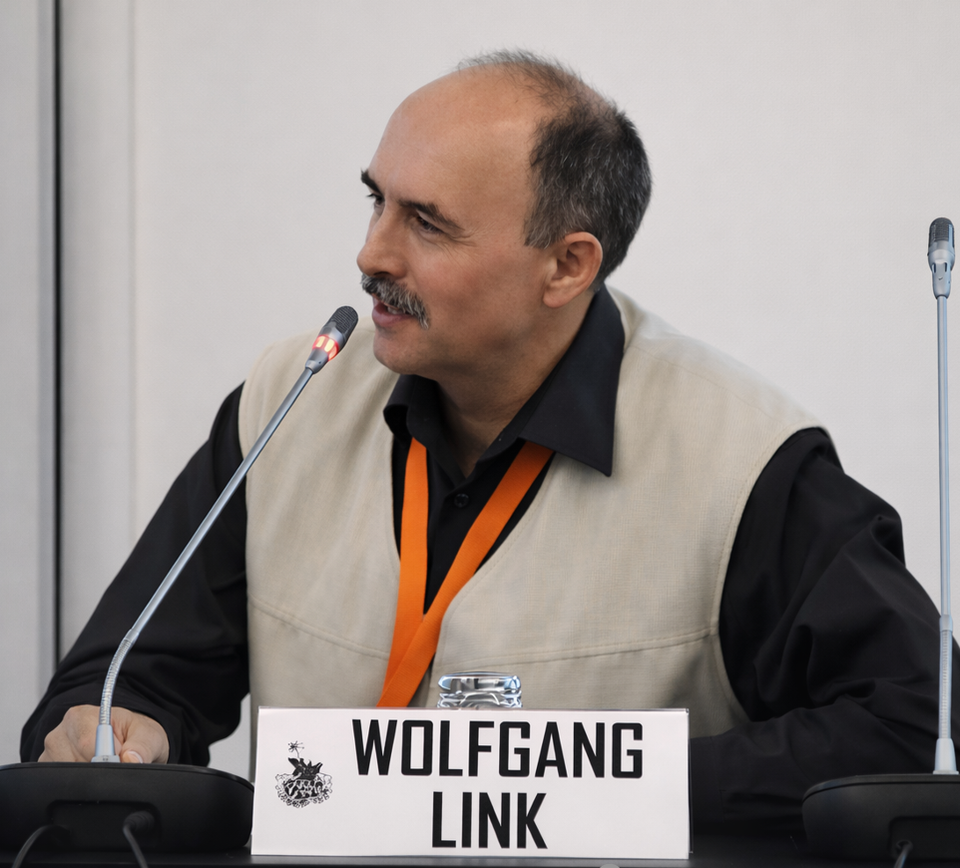
Sequential Number: #24
UNPLAB-BrMeth_Ch-6[RecSel II]
In case you have arrived here without any prior information: This is a chapter from a series of chapters, intended as learning modules for the agricultural subject of Plant Breeding, at the level of a scientific Master's degree. There are no credits and no guarantees, and you - yourself - are responsible for what you take away, what you learn, and how you deal with content, form, shape and mood ;-)
© Wolfgang Link, Göttingen, Germany, 2025
This symbol usually indicates that a page is rather important
© WL
2

Slide 3
You already know:
Population Genetics. This mean pertinent items and topcis such as
Genotype frequency, Allele frequency, Hardy-Weinberg-Equilibrium, Inbreeding coefficient,
Kinship (this one, for instance, find it in „PopGen_Ch-3“ which has sequential number #4,
in about page 29 there); Selection, Drift, Migration, Mutation.
And you have studied the chapter BrMeth_Ch-5, the one before this one, so that you are used to the cyclic feature of Recurrent Selection, the share of tasks between Selection Unit, Test Unit, Recombination Unit.
Algebra
A diallel among e.g. N=12 components makes a minimum of N=66 crosses.
The round-robin design: 1x2; 2x3; 3x4; etc. until 10x11; 11x12; 12x1;
each line once as male and once as female; makes N=12 crosses.
The chain-crossing design: 1x2; 3x4; 5x6; 7x8; 9x10; 11x12 makes only N=6 crosses.
3

Slide 4
Here, VIII methods of recurrent selection are presented.
After [I] Recurrent Mass Selection in the last chapter, now we proceed ...
[II] ‘Recurrent selection on highly heritable traits*, such as oil quality in sunflower (e.g. ‘high-oleic-low-linolenic oil’ types of sunflower).
*aka “Recurrent Selection on phenotypic traits”
(a slightly strange term imho).
*https://s.gwdg.de/GDIIXp
4

Slide 5
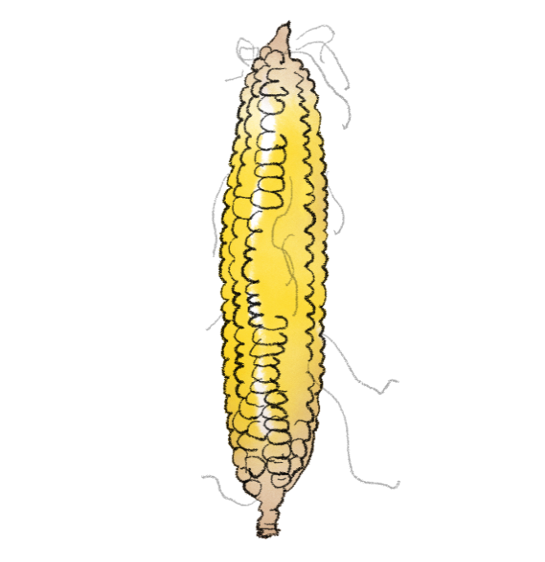

[II] Recurrent Mass Selection on phenotypic traits.
Base population: Self-fertilize selected individuals
Not each naturally cross-fertilizing species allows to be self-fertilized.
For instance:
Maize and sunflowers fit.
Alfalfa & many grass species ...
don’t fit.
Recombine their selfed offspring (for instance via diallel mating).
Recombine
© G. Cerny
et
cetera
Extract cultivar
Cultivar
© HL
5

Slide 6
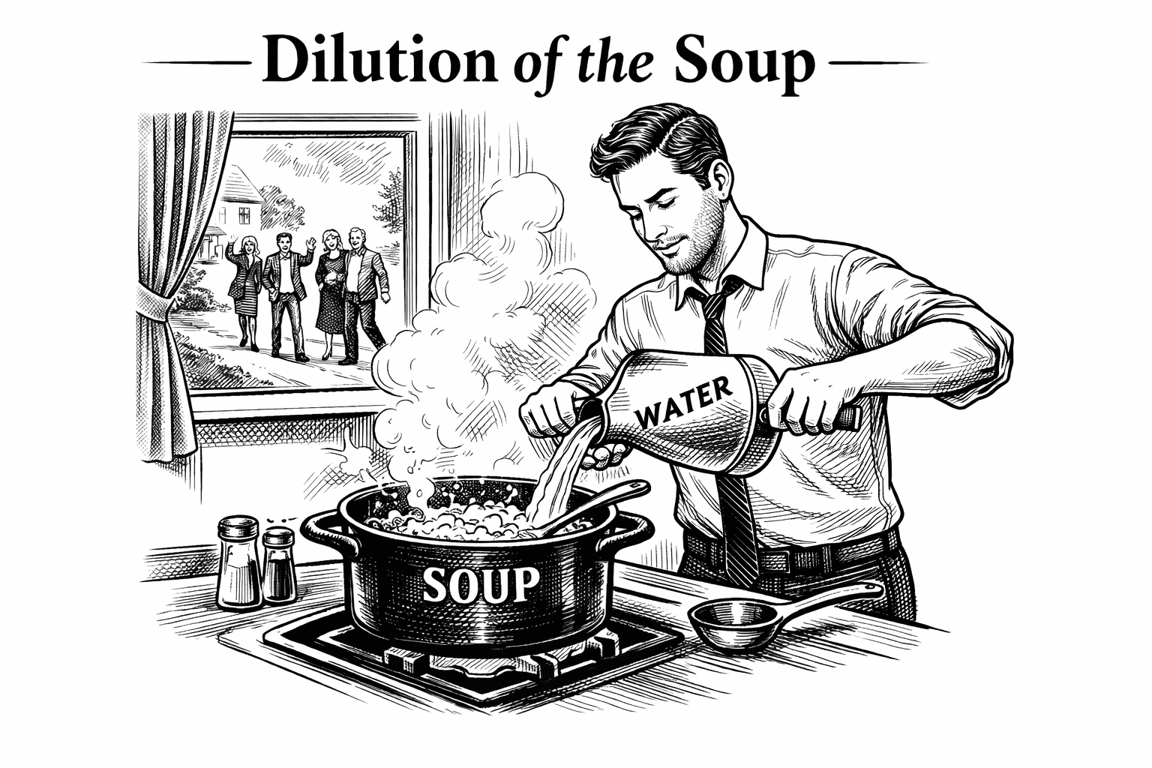
Surprise. Unannounced guests are arriving, important guests, quickly add water to the soup so there's enough for everyone. Well, that's just Diluting of the Soup.

Slide 7
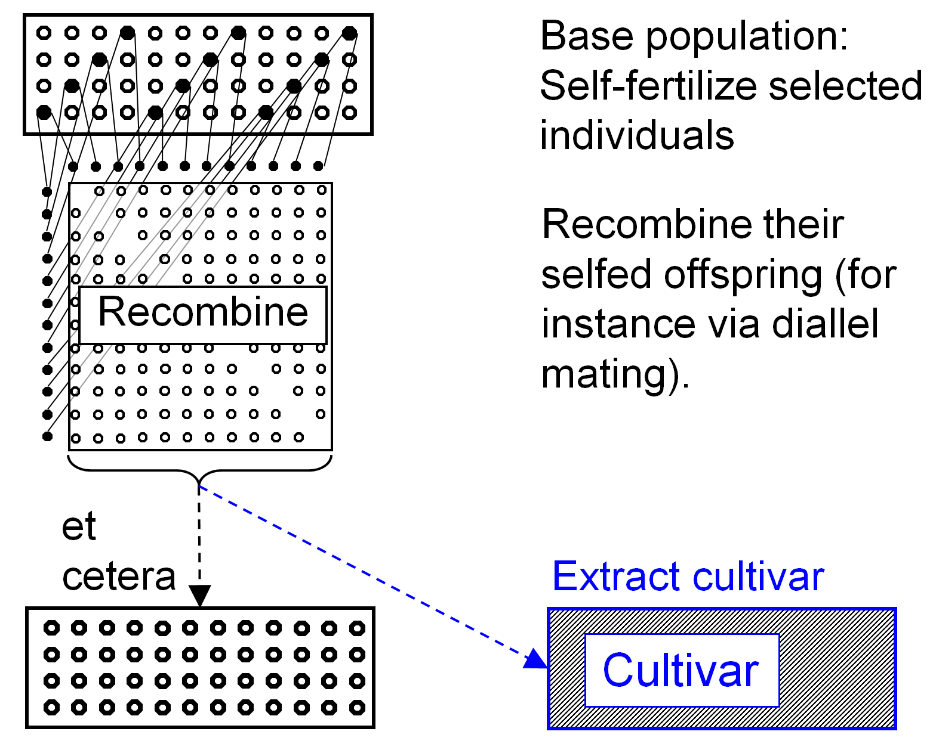

Recurrent Mass Selection on highly heritable traits.
A ‘Dilution of the Soup’ is avoided; we take full control on the fathers. Due to selfing, the selected plants are not only the mothers but as well fathers of offspring: Only genes from selected plants are passed on. The plants which are used for recombination are once-selfed offspring of the selected individuals. They are half-inbred*. After the recombination, a new generation, an improved population exists for the next step of selection and selfing.
© G. Cerny
Again: Not the selected plants them-selves are recombined (so, here, the Selection units are not identical to the Recombination units), but individuals of their S1-lines serve as recombina-tion units.
How to recombine? ‘Cross each with each’ is rather a sledgehammer to crack a nut.
It is very laborious & costly. Breeders oftentimes employ simpler, cheaper designs. Only a limited number of selfed seeds per selected plant will/can be employed to recombine. .. DOI: 10.1534/genetics.109.108449.
*Not only are they ‘half inbred’, but in addition they ‘come from segregation’ ... so ... how many selfed individuals per plant do we then need to catch - say - 90% of the ‘genetics’ of each selected plant?
7

Slide 8
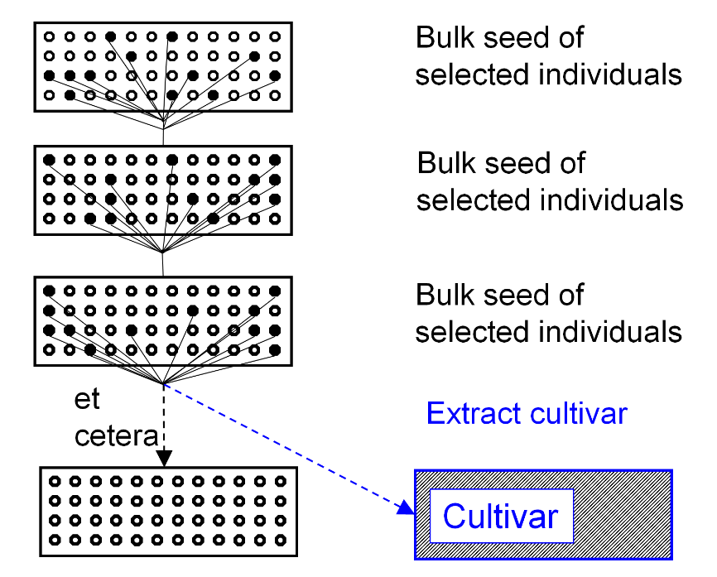
Recurrent Mass Selection. With [A] ‘first dilution of the soup’ and without [B].
[A]
[B]
Recombination. Compared to [A], in [B] we need a separate step for this, this takes time, effort.
In [A], recombination happens ‘automatically’, by the natural reproductive mode of the plants, and in each season. This acceleration is paid by allowing the said Dilutions of the Soup in [A].
In [A], the diagram shows three cycles of recurrent mass selection and indicates further ones, whereas
in [B], the diagram shows one cycle and the start of the second cycle of Recurrent Mass selection.
8

Slide 9
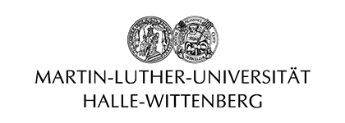


Two famous, competing places in the development of maize breeding methodology.
Behind stage, the German plant breeder Theodor Römer, University of Halle (‘Restsaatgutmethode’)
University of Illinois
at Urbana-Champaign
Ohio University at Athens Ohio
9

Slide 10
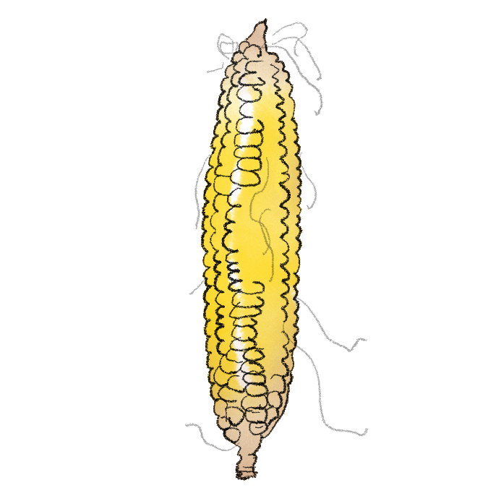
Base population
Select individuals
[III] Recurrent selection labelled
‘Ear-to-Row Method’ à la ILLINOIS
Select families & individuals within
Select families & individuals within
Select families & individuals within
© HL
et
cetera
Extract cultivar
“Ear-to-Row”
Cultivar
10

Slide 11
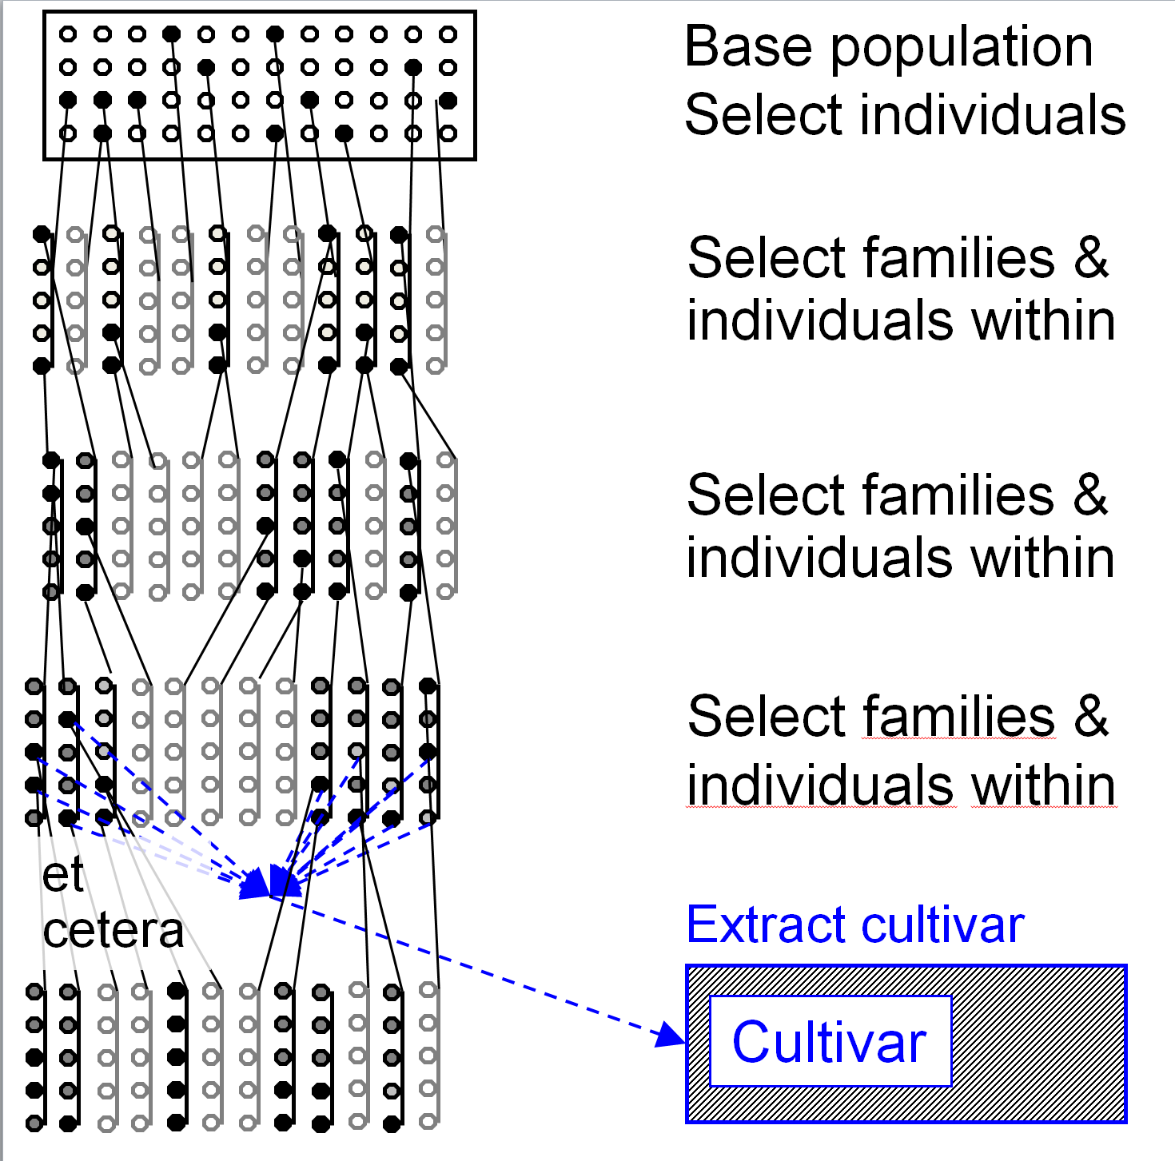
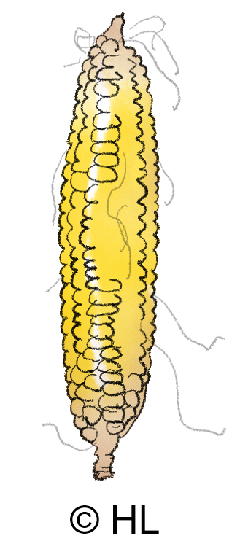
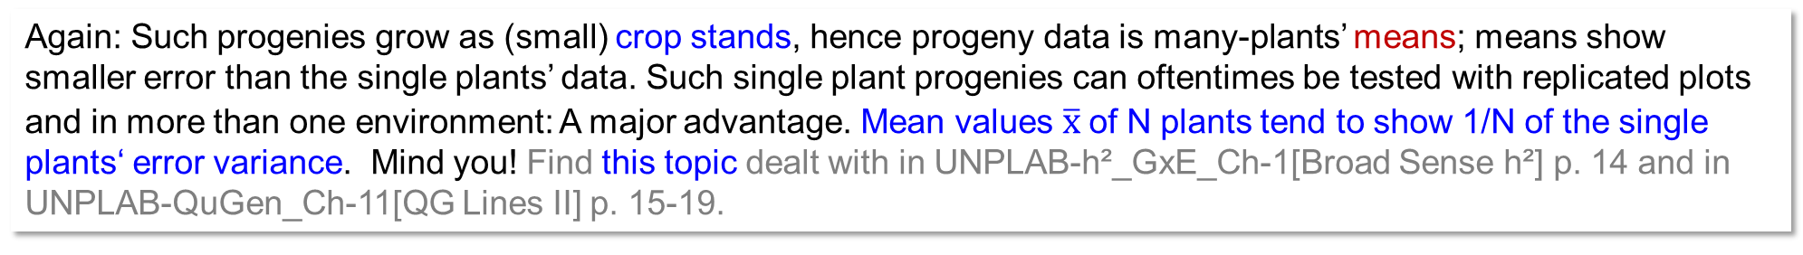
[III] Phenotypic Recurrent Selection as
‘Ear-to-Row Method’ à la ILLINOIS; in corn.
Default start: Exploit given diversity of a base population, apply Mass Selection of superior individuals. Yet, their offspring is not bulked but kept separately from each other: Individual progeny (families) are sown and tested.
This Progeny-Testing is a major distinction, invention and improvement as compared to Recurrent Mass Selection! Phenotypic data from offspring are much more reliable than phenotypic data from single plants. Yes, offspring is typically heterogeneous and here (open pollination) it contains 50% of genes that doe not stem from mother plant – clear disadvantages. But: This is often more than compensated by the advantage of having average data from very many plants, hence, much less blurred by the large single-plant experimental error!
Again: Such progenies grow as (small) crop stands, hence progeny data is many-plants’ means; means show smaller error than the single plants’ data. Such single plant progenies can oftentimes be tested with replicated plots and in more than one environment: A major advantage. Mean values $\overline{x}$of N plants tend to show 1/N of the single plants‘ error variance. Mind you! Find this topic dealt with in UNPLAB-h²_GxE_Ch-1[Broad Sense h²] p. 14 and in UNPLAB-QuGen_Ch-11[QG Lines II] p. 15-19.
11

Slide 12

Phenotypic Recurrent Selection in corn
‘Ear-to-Row Method’ à la ILLINOIS
The Illinois method can include a step of selection of best individual plants within families; at first, select among, thereafter, select within best entries. ‘Illinois Ear-to-Row’ is without ‚Remnant-seed‘ (see next pages). The first dilution is not avoided (es claro?). There are - here - even further ‘Dilutions of the soup’, which is a marked issue – you surely see that in each step all plants, even the inferior ones, are allowed to pollinate seed for the next cycle – do you (trait is yield hence selection is after flowering)?
♂
♀
The Illinois Method has its focus on selecting the superior mothers, the mother individuals and their offspring as mothers of further offspring. Basically, this method exerts control (applies selection pressure) only on one of the two sexes, the female side. This seems suboptimum when compared to an approach that exerts control on both parents, mothers and fathers.
What then are the good aspects of this approach? Make a few notes on your ideas before we continue.
© HL
12

Slide 13
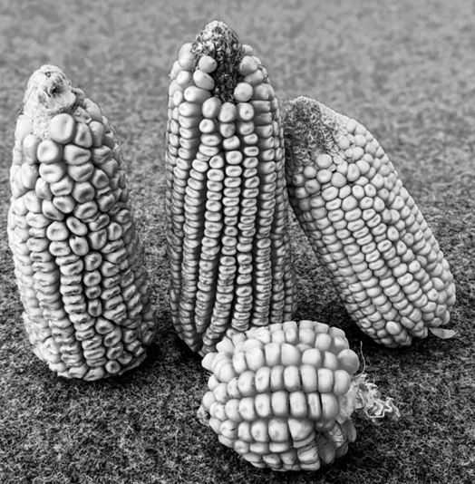
Base population: Select individuals
[IV] Recurrent selection labelled ‚Ear-to-Row Method’ à la OHIO
Select families.
Use Remnant seed to ...
... recombine. Select individuals
Select families.
Use Remnant
seed …
© T. Beissinger
Extract cultivar
Cultivar
et cetera
13

Slide 14
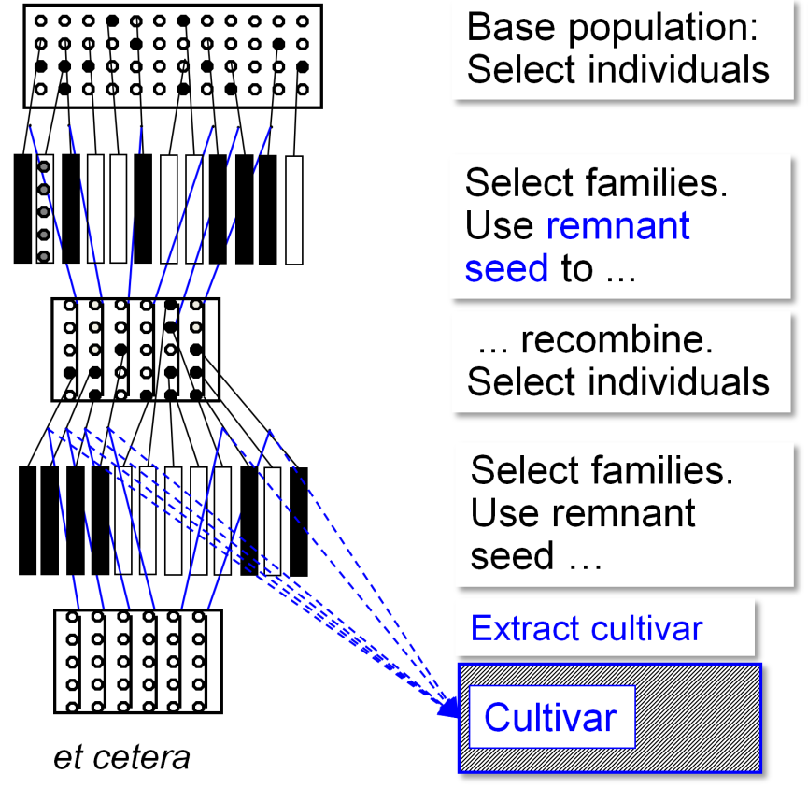
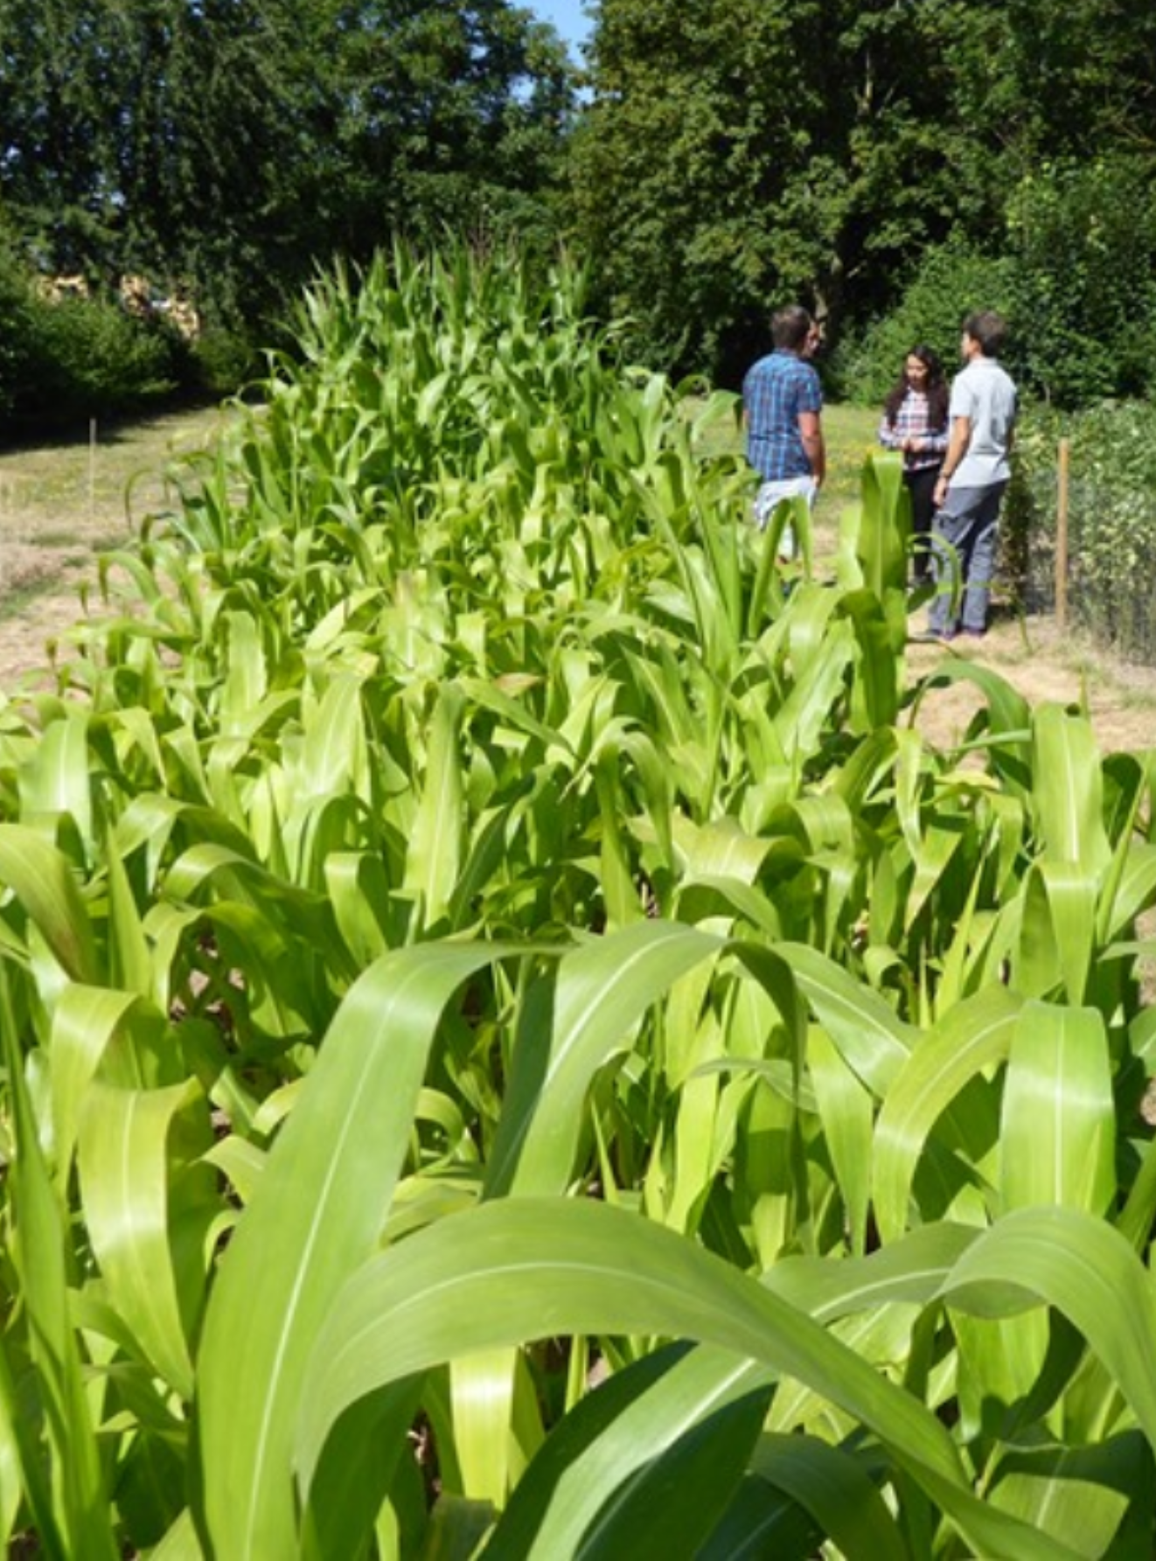
Recurrent selection labelled ‚Ear-to-Row Method’
à la OHIO
Offspring is sown as plots (rec-tangles); only one rectangle ‘ad-mits’ its composition from indivi-duals ;-) . Selection is only bet-ween offspring (i.e. between their parental individuals), not within offspring. Grain produced by these offspring is not used as seed, but just to assess (yield) performance; as data for selection. (Field and plot-based) selection happens only in every other season (step). In-between, one step is devoted to recombination.
Some remnant seed of selected entries, i.e. seed which was not used for sowing and field-testing their offspring (families) in the first place but was spared instead
(stored) ...
A field plot is composed from many plants.
... is used to recombine; and produce seed for the next plot-based testing and selection. What is often referred to as Ohio-Method or ear-to-row recurrent selection is what the Ger-man breeder Roemer proposed as ‚Restsaat-gut-Methode‘, i.e. Remnant Seed Method.
© SY
14

Slide 15

[IV] Recurrent selection labelled Ear-to-Row Method à la OHIO
Like in ‘Illinois’, the ‘first dilution of the soup’ is not avoided here, since there and here, plants in the base population are (mainly) selected for yield, hence main selection hast to be at maturity which is after flowering (and the selected ones are hence fertilized by the good and the bad plants).
But then, to recombine, the ‘Second Dilution’ is avoided. Hallelujah! Seed harvested from tested offspring – which was again (second time) pollinated by ‘anybody’ – is not used for sowing.
Instead, remnant (once-only diluted seed) is used.
As it avoids the second dilution, Ohio exerts selection pressure on the female and on the male side.
Whether all (or a representative sample of) seed harvested from the recombination plot is used to sow again (next cycle) ‘ear-to-row’ single-plant offspring ... or whether a certain selection is exerted there, this is up to the individual judgement of the breeder.
15

Slide 16
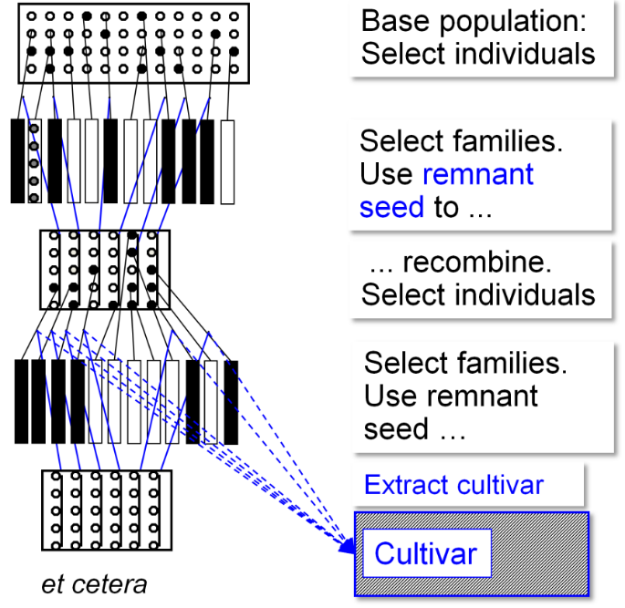
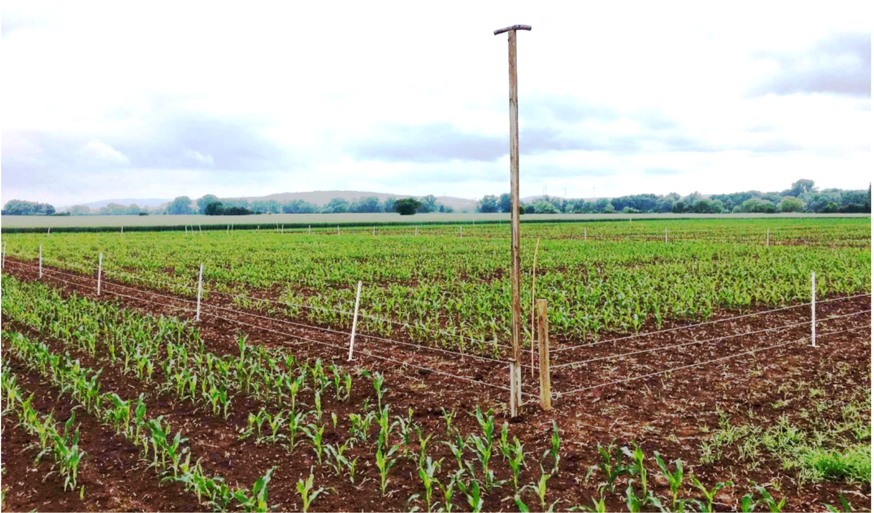
Recurrent selection labelled Ear-to-Row Method à la OHIO
The recombination plot will usually be only grown at one place, hence, only weather and climate at one place might (can) impact the selection in that season. The crop stand for recombination can be optimized for the outcrossing and seed production purpose. Maybe there is randomization to avoid systematic neighbourhood of related offspring ... or there is low plant density and good phytosanitary protection to allow a high seed yield per plant for more replicates etc. in the upcoming progeny test. ...
© WL
Since, today, we may have options to genotype (DNA-analyses) the candidates or the selected individuals, we may use such date to avoid fast decay of genetic diversity or to optimize randomization in the recombination plot. We even may use DNA-data to select DNA-based, in this or in other recurrent selection schemes. See later: ‘Marker Score’ and ‘Genomic Selection’; UNPLAB-BrMeth_Ch-11[TheFour GS].
16

Slide 17

Ilinois: Performance test each season (step), hence selection each season. Second and further dilutions not avoided, hence less genetic variance between families available for selection. Off-season nursery not useful. Recombination partly ‚within‘ families (not really random).
Illinois
17

Slide 18

Ilinois: Performance test each season (step), hence selection each season. Second and further dilutions not avoided, hence less genetic variance between families available for selection. Off-season nursery not useful. Recombination partly ‚within‘ families (not really random).
Illinois
Ohio
Ohio: Second dilution avoided. Performance test (with selection) only each 2nd season. This may be risky: Seasons with e.g. important stress events (drought, virus attack ...) may be missed for selection if the recombination step happens to occur then. Yet, either ‘staggering’ (see later) or use of an off-season nursery may overcome this and allow to still have the performance test and the selection in the target environments and in each season (not missing any for selection). Recombination can be organized nearer to ran-dom mating (‚polycross‘). Further optimizations are possible. This may lead to high seed yield thus larger plots, more replicates & locations for the field test, thus better data.
Selection between individuals in the recombination plot is an option.
18

Slide 19
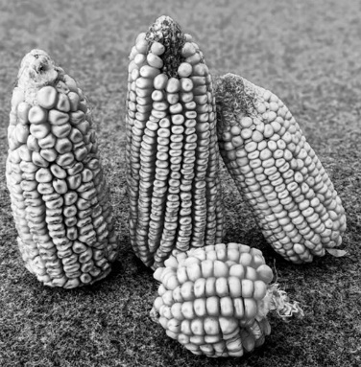
[V] Recurrent S1-line Selection. Recurrent Selection Method number 5.
S₀-individuals are the not (not-yet) selfed plants, i.e., the ‘normal’, non-inbred individuals of the base population.
S₁-line selection requires that the crop species can easily be self-fertilized and that once-selfed offspring (S₁-line) shows meaningful, useful performance.
Again: As the S₀ are the non-inbred members of the breeding population, they – each single one – are equivalent to one F₁ hybrid individual.
Mind. Each S₀ comes from a unique (random) female and male gamete. Imagine if we had first transformed these two gametes into two DH lines and then crossed the two ... We would have obtained the same F1 genotype ! Klar ?
See UNPLAB-PopGen_Ch-2[HWE II] p. 14-17 .
Therefore, if S₀ ≡ F₁, then-therefore S₁ ≡ F₂.
S₁-line means F₂-family. Aha!
Base population:
Select and self-fertilize S₀-individuals
© TB
Select between
S₁-lines
Use remnant selfed seed to recombine
Recom-
bine
Extract cultivar
et
cetera
Cultivar
19

Slide 20
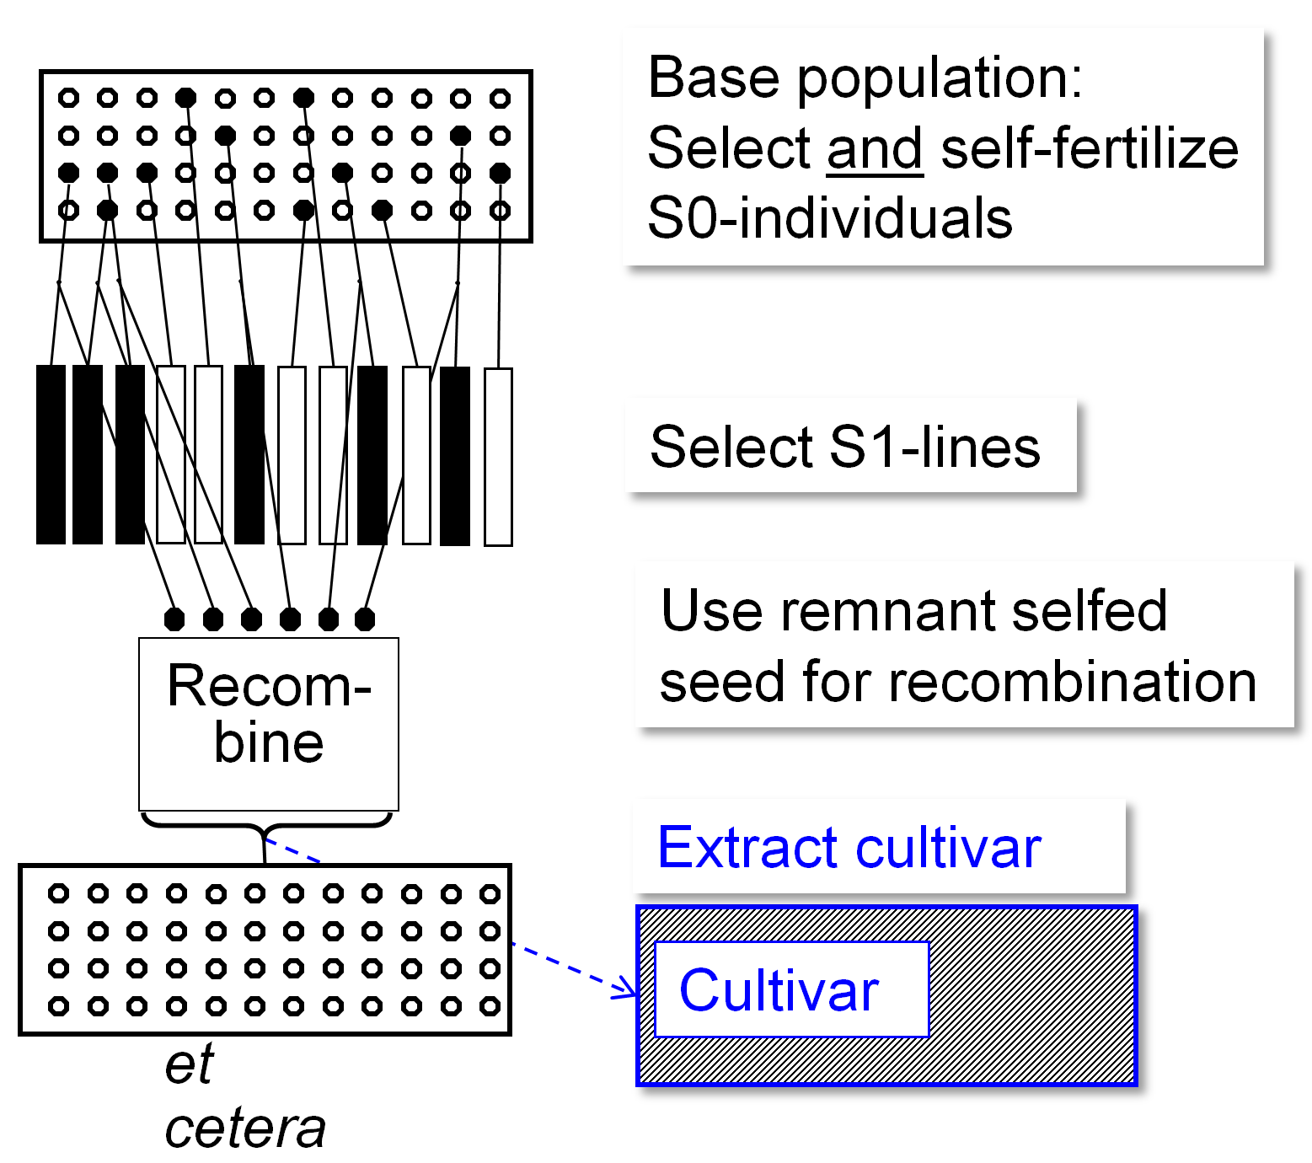
[V] Recurrent S1-line Selection.
This is the attempt to avoid any ‘dilution’ and substitute single plant selection by progeny-selection (progeny-testing).
This is achieved; yet, ‘paid’ by having (pheno-typic) selection only once in three seasons. Staggering may be an option (see next page). Selection is based on half-inbred material, whereas cultivars probably perform with no or little inbreeding – this may be an issue.
The recombination scheme may be simpler than a full diallel pattern of crossing. A Diallel among e.g. N=12 compo-nents makes a minimum of N=66 crosses.
The Round-Robin Design: 1x2; 2x3; 3x4; etc. until 10x11; 11x12; 12x1;
each line once as male and once as female; makes N=12 crosses.
The Chain-Crossing Design: 1x2; 3x4; 5x6; 7x8; 9x10; 11x12 makes only N=6 crosses.
20

Slide 21
Staggering subpopulations (DOI 10.2135/cropsci2007.04.0223).
Staggering breeding subpopulations, to reduce decay of genetic variance.
Recom-
bine
Recom-
bine
Recom-
bine
et cetera
et cetera
21

Slide 22
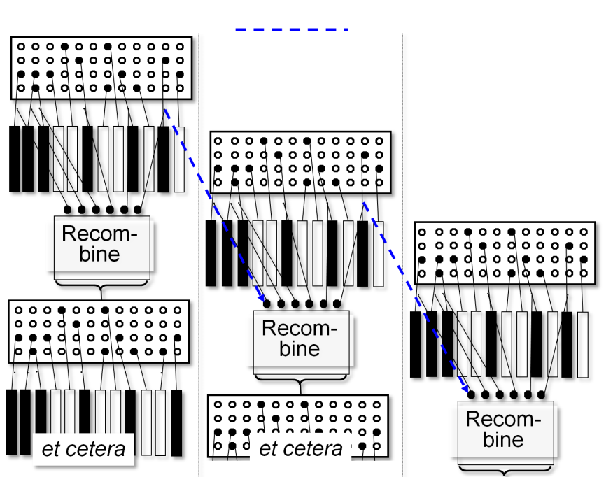
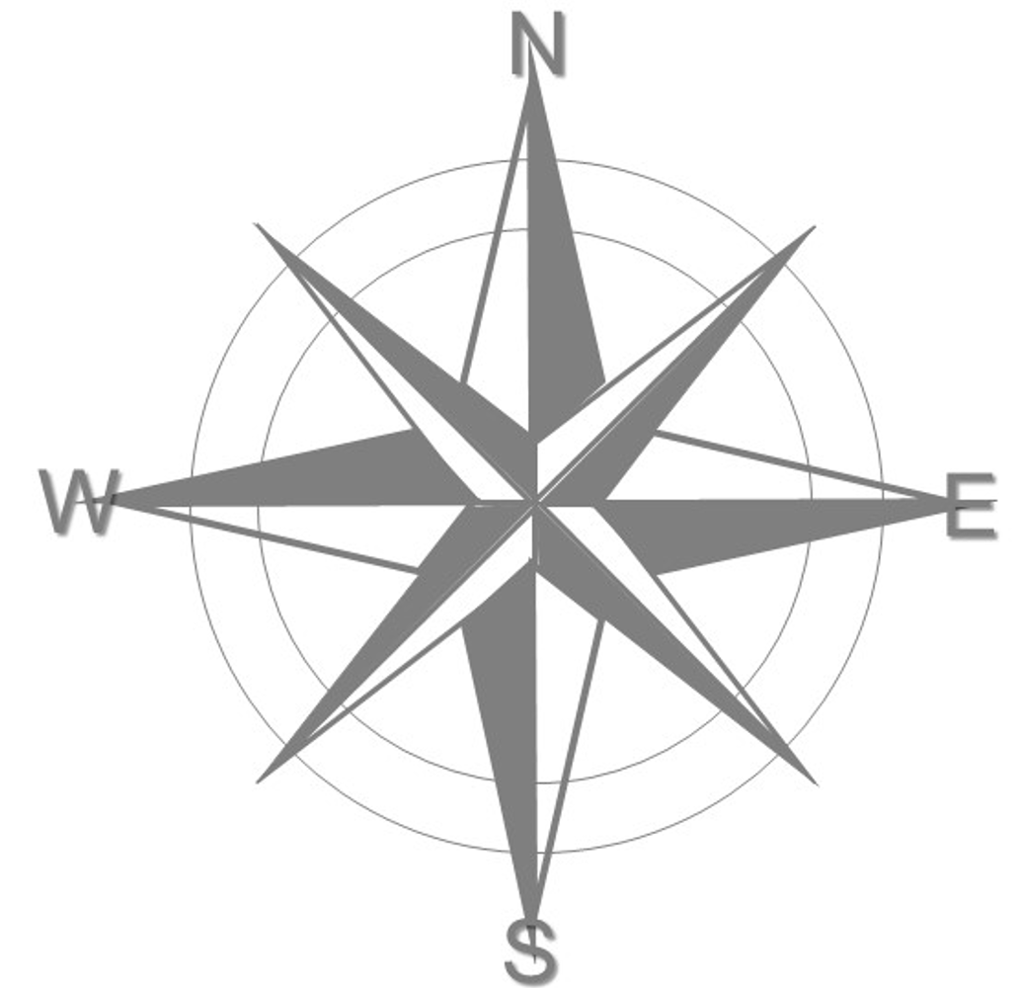
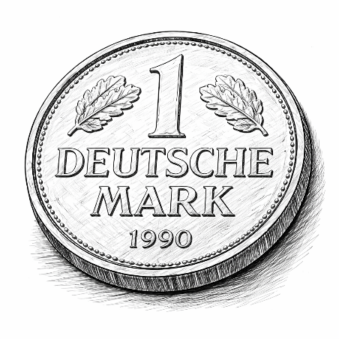

Staggering breeding subpopulations (cohorts of generations and cycles) that trace back to the same point of start and material of start).
1
2
3
4
5
One motivation for ‘Staggering’ or ‘Interlinking’ is the increase of genetic diversity that can be passed through the recombine-tion step into the next generation.
A different motivation is the intention to not let a subpopulation ‘go astray’: To not let it develop too much away from adapta-tion to the target population of environments. Such risk exist. Assume that the seasons 2 and 5 were dry, all others were not dry.
© WL
First cohort
In such case, selection in the first cohort was based twice in sequence on performance data under drought, although drought occurred only in two of five seasons. The other subpopulations were not selected for drought tolerance at all. Staggering and interlinking will diminish the resulting divergence between cohorts. Altogether, there is some selec-tion decision taking place each season, no season (no season’s climatic peculiarity) is missed.
22

Slide 23
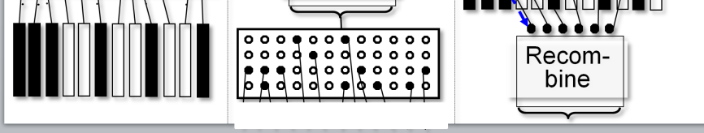
Staggering breeding subpopulations
Staggering allows to conduct in each season (or calendar year) about the same amount of labour and the same steps. This is a major advantage, compared to work with only one subpopulation: That would ask for little work in one season (self-fertilization of selected individuals), much work in the next season (field trials with replicated plots and assessment of several traits) and little work in the third season (mix selfed seed and let it freely cross-fertilize to produce seed for the upcoming next cycle).
1
2
3
4
5
© WL
“All steps and same amount each season”
23

Slide 24
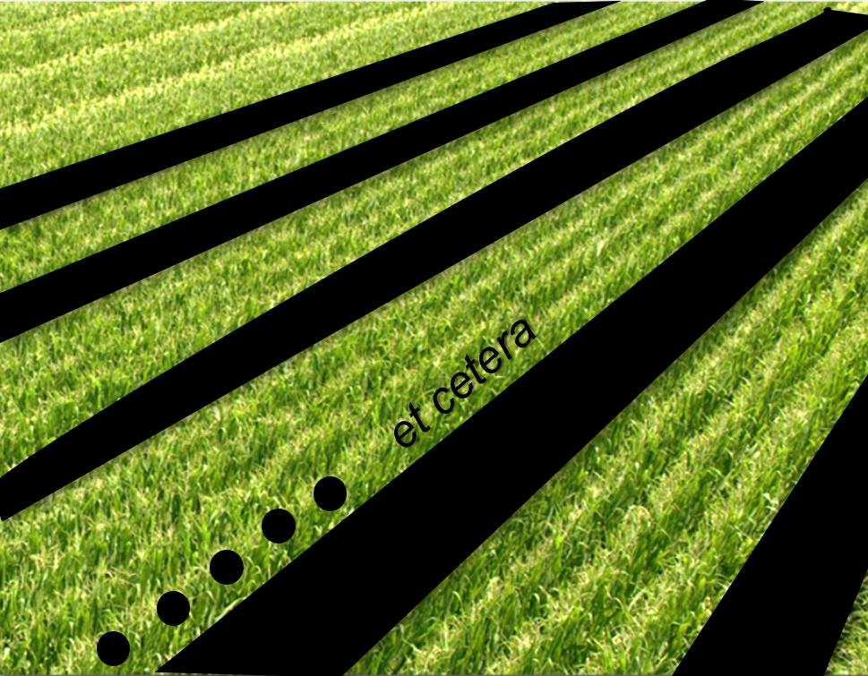
[VI] Recurrent Selection for General Combining Ability
‘Tester’ (female)
Base population: Self-fertilize S0-individuals
and cross-fertilize them
with a ‘Tester’.
Evaluate offspring from crossing
Use selfed seed for
recombination
Recom-
bine
You may extract candidate cultivar
●●● Candidate individuals (Selection Units). Cross each candidate as father with a number of individuals of the fe-male tester to produce enough off-spring to test it in field (this then: Test Unit); number of candidates N=high)
Cultivar
et cetera
24

Slide 25
[VI] Recurrent Selection for General Combining Ability
Base population: Self-fertilize S0-individuals
and cross-fertilize them with a ‘tester’.
This is the initial breeding population, the population of non-inbred individuals which are available as breeding germplasm to start this recurrent selection. The black-filled circles are the better individuals. All else drawn in the blue box on the left side is just to indicate the manu-al crossing between selected plants of this population and the tester plants ...
which do not belong to the Breeding Population.
Evaluate offspring. Select between them.
Use selfed seed for
recombination
Recom-
bine
Extract cultivar
Cultivar
et cetera
25

Slide 26
[VI] Recurrent Selection for General Combining Ability (manually selfing & crossing)
Tester
Base population: Self-fertilize S0-individuals and cross-fertilize them with a ‘tester’.
Cross candidate plants ● ● ○ as fathers (pollinator) with several plants of a genotype that serves
as ‘tester’.
The tester here is the female parent. This
may take some getting used to at first, but
is not really unusual when looking across methods and crop species.
Crossed seed is used to test such experimental hybrids (▲ x ; tester x candidate S₀ plant) in field experiments.
Again: The individual plants of the Breeding Popu-lation ● ● ○ are the candidates, the Combining Abi-lity of which is analysed via testing their manually crossed progeny.
(Combining Ability towards this tester genotype; cf. UNPLAB-BrMeth_Ch-3[GCAI], page 7 ff.
The tester here is the female parent.
Evaluate offspring
Use selfed seed for
recombination
Recom-
bine
Extract cultivar
Cultivar
et cetera
26

Slide 27
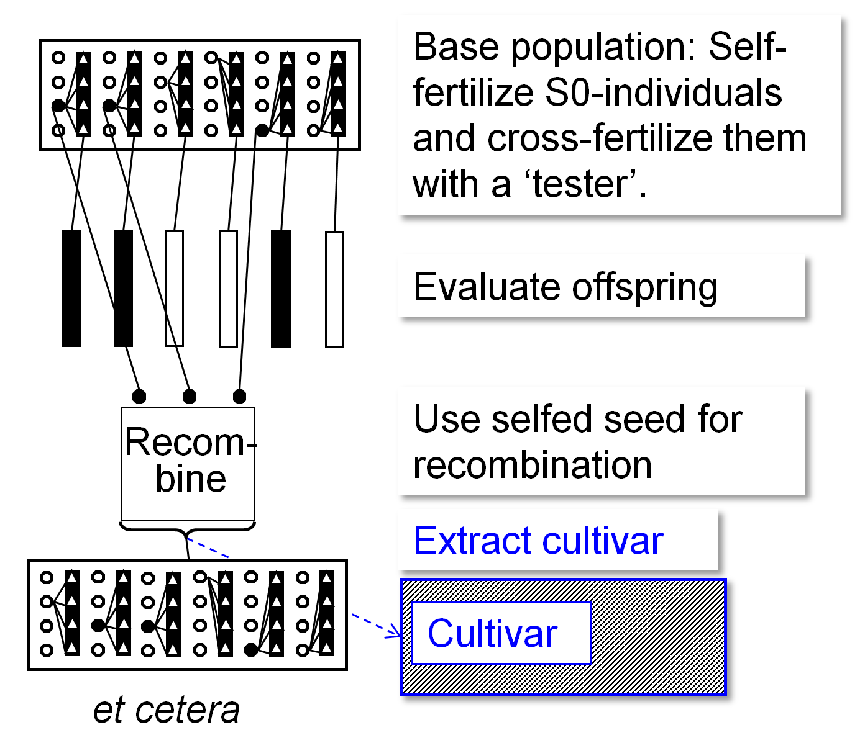
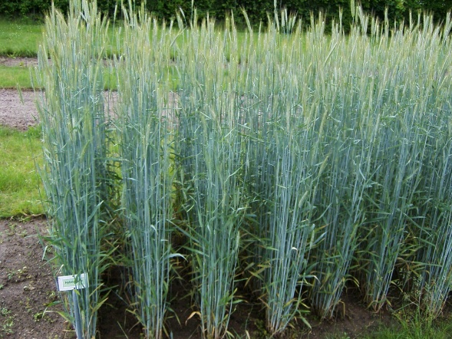
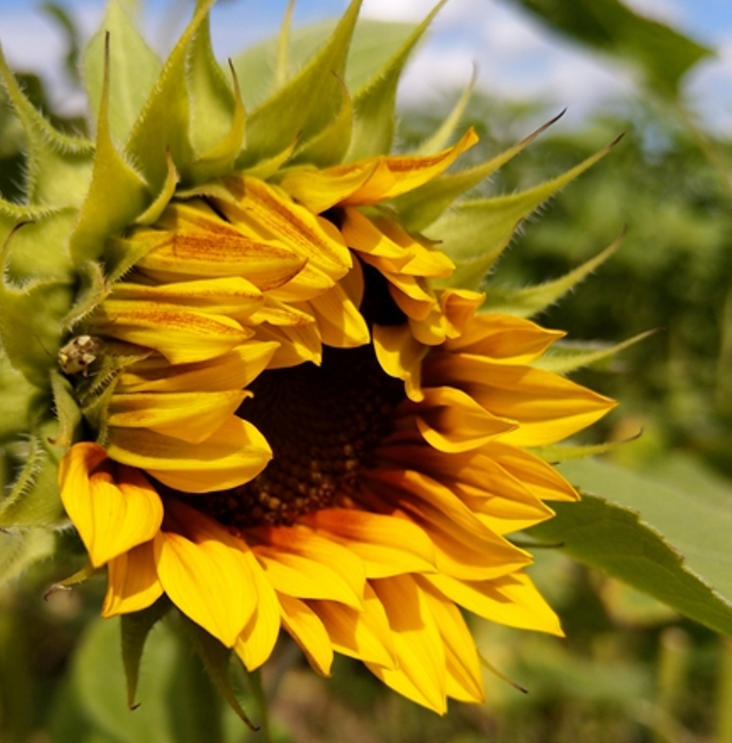
Recurrent Selection for General Combining Ability
Scheme does not suffer from ‘Dilution’, because candidate plants are self-fertilized in parallel to the creation of test-hybrids (test-crosses). Few plant species allow this (e.g. maize Zea mays). Moreover, the field-tested offspring has same (non-inbred) inbreeding level as the aimed-at cultivar. Since tester can be freely chosen, testers can be genetically homogeneous (such as a pure line or a Mendelian F1) or heterogeneous (such as an S1-line or a population), inbred or not, can belong to the same or a different germplasm pool (this is touching the big field of ‘Choice of Tester’).
© W. Link
Different from Recurrent S1-line selection, here the variance between offspring is markedly reduced, because all offspring share same tester as common parent. This makes all offspring somewhat similar. Especially dominant alleles, contributed from tester, ‘cover’ genetic differences between the candidates, make genetic differences invisible. Some breeders vote for ‘weak’ testers, i.e., for testers that inherit recessive alleles (which are very often unfavourable). This approach has its own drawbacks ... ;-)
© HL
27

Slide 28
[VII] Reciprocal Recurrent Selection for General Combining Ability
This scheme is not directly leading to a cultivar, its pur-pose is to simultaneously improve two base populations for their ability to give components (inbred lines) for Hybrid Cultivars (● x ●) .
Indicated in diagram: The circled (red) plants are the candidate individuals (genotypes) of Genepool A (which is used as tester for Genepool B).
The triangles (▲) are
the candidate plants of
Genepool B (which is
tester for Genepool A).
Of course, most recent
cycles’ seed from A is
used as current tester
for B and vice versa.
Recom-
bine
Recom-
bine
Genepool A
Genepool B
© TB
28

Slide 29
[VII] Reciprocal Recurrent Selection for General Combining Ability
Two Base Populations. Self-fertilize S0-individuals, simultaneously cross-fertilize them (as male) with (female) tester individuals (tester is the ‘other’ population).
Evaluate offspring in field trials.
Recom-
bine
Recom-
bine
Employ selfed seed for recombination
(e.g. Diallel cross; Chain Crossing Design; etc.).
Onset of next cycle; the two populations are improved for their mutual General Combining Ability.
Genepool A
Genepool B
29

Slide 30
We have to admit that in all these methods of recurrent selection, we did not specify any numbers or quantities; we ignored a topic named ‘Allocation of Resources’.
How many plants to take as candidates? Plot size, number of replications, number of locations and seasons for the field tests? How strict to select? How exactly to recombine?
How many cycles to go unless new (alien) material is drained into our germplasm; or unless cultivar development can be started?
More questions linger backstage ;-)
Let us at least add Allocation data ...
30
https://s.gwdg.de/erbR6w

Slide 31
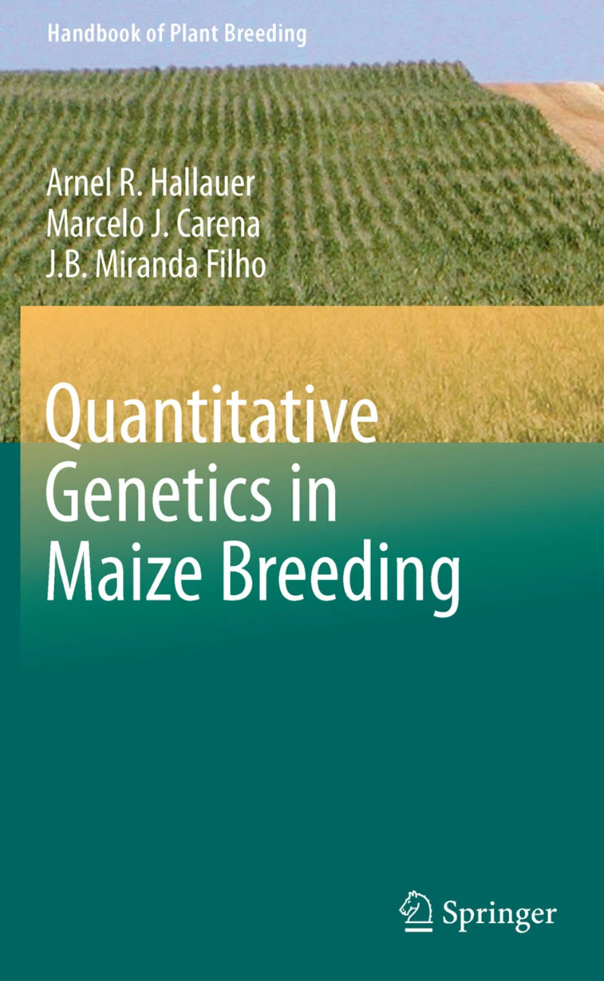
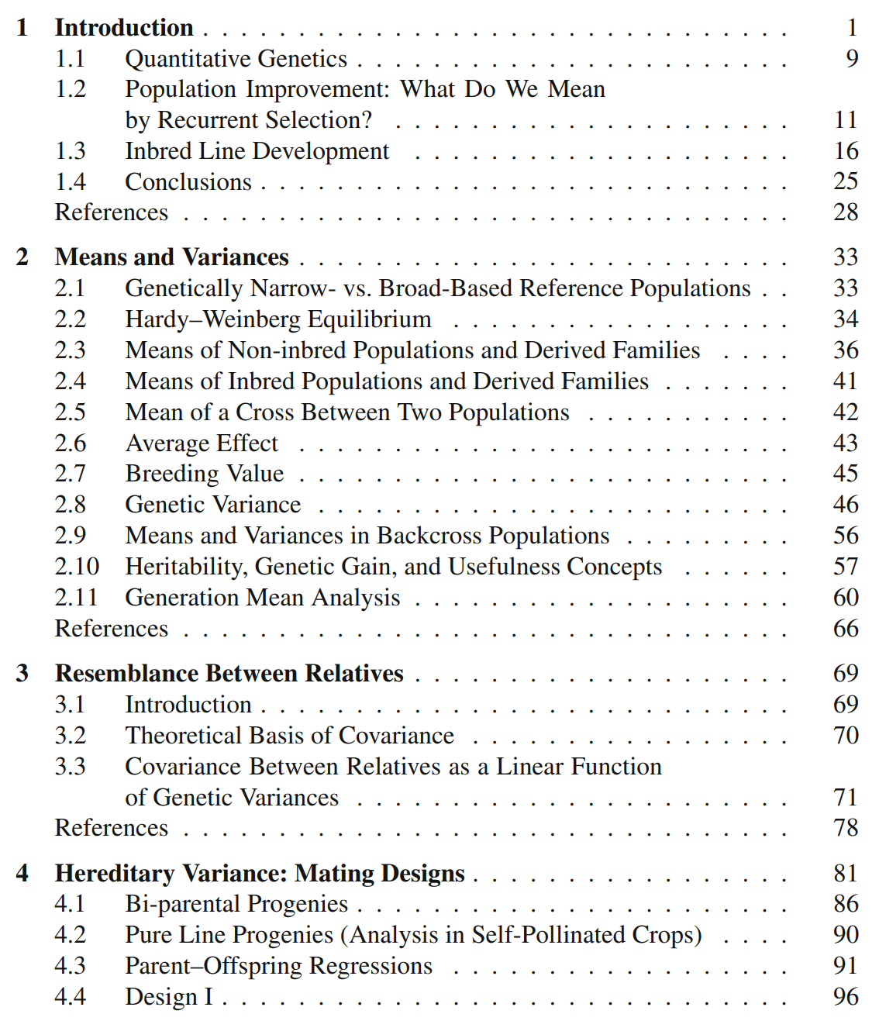
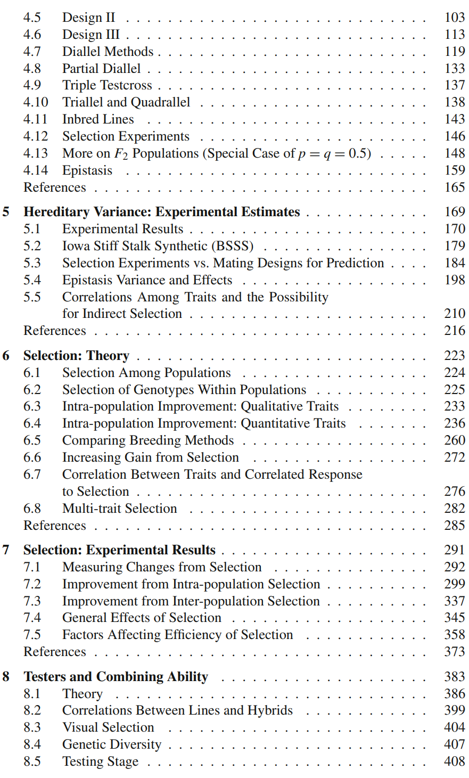
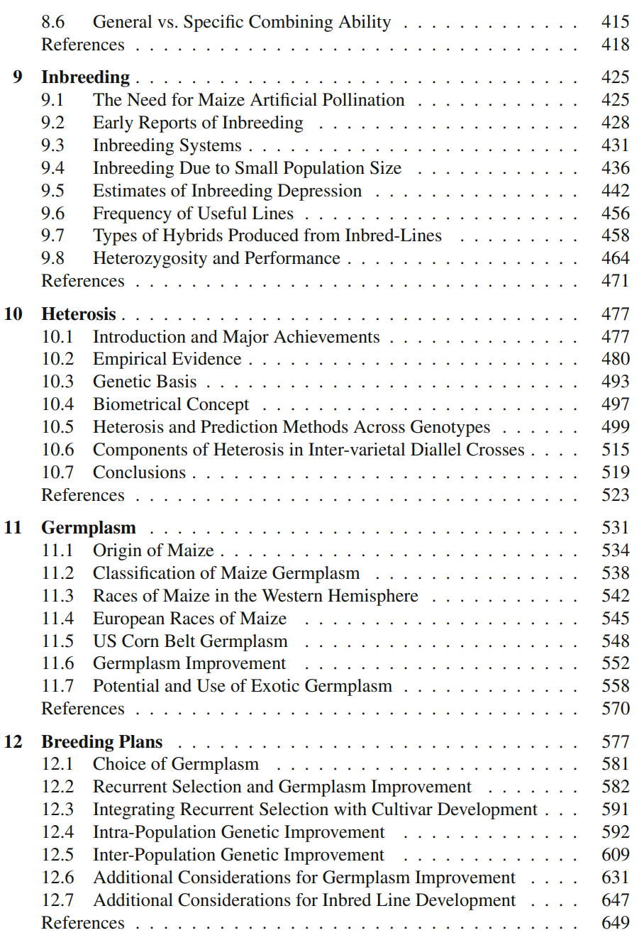
From here you may go to UNPLAB-BrMeth_Ch-7[RecSel III]
https://link.springer.com/book/10.1007/978-1-4419-0766-0#toc
One of several good sources to study even deeper. See for example chapter 12 of this book.
Alternatively see the chapters of UNPLAB-QuGen ;-)
31
31

